Slide 1
NEWS AGGREGATOR
A modern platform for discovering and organizing news
7-Slide Project Presentation
Homepage • Categories • News Discovery • User Accounts
ID – 2500040025
ID – 2500040018 ( Team Leader)
ID – 2500040035
1

Slide 2
Project Overview
What the News Aggregator is designed to do
Core Purpose
Collect and present news topics in a single interface.
Give users fast access to trending and latest stories.
Organize content into clear categories such as Technology, Sports, Education and Entertainment.
Provide account creation for a more personalized experience.
Keep navigation simple so users can move from discovery to reading with minimal friction.
Trending
Surface topics that are currently attracting attention.
Latest News
Present fresh stories in a compact feed.
Categories
Let users browse news by subject.
Accounts
Support sign-up and personalized experiences.
2

Slide 3
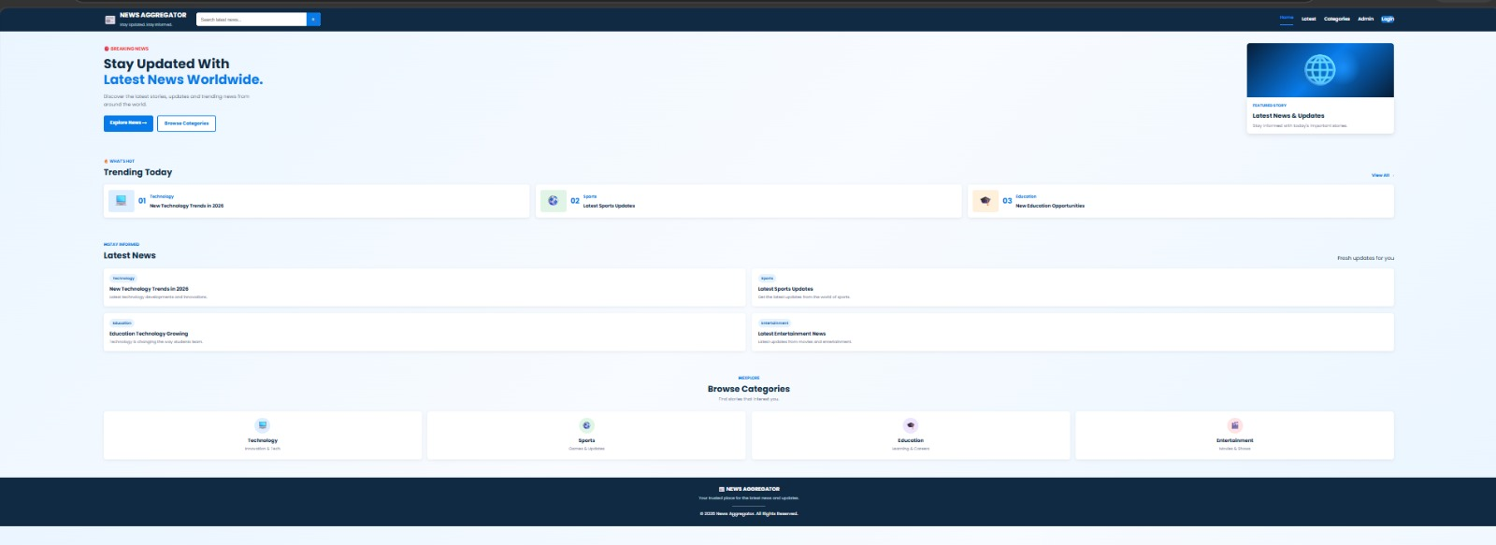
Homepage & News Discovery
The landing page combines search, trending topics and latest stories
Homepage interface
3

Slide 4
Main Interface Components
How the homepage is structured
Navigation Bar
Logo, search, Home, Latest, Categories, Admin and Login.
Hero Section
Introduces the platform and provides direct actions such as Explore News.
Trending Today
Highlights major topics across different categories.
Latest News
Shows fresh stories in a compact, scannable layout.
Browse Categories
Provides category-level navigation for focused discovery.
Footer
Reinforces platform identity and basic site information.
4

Slide 5
Categories & Content Organization
The category structure makes a broad news feed easier to navigate
1
Technology
Innovation, gadgets, AI and digital trends.
2
Sports
Matches, teams, athletes and sports updates.
3
Education
Learning, institutions and education opportunities.
4
Entertainment
Movies, media, culture and entertainment stories.
5

Slide 6
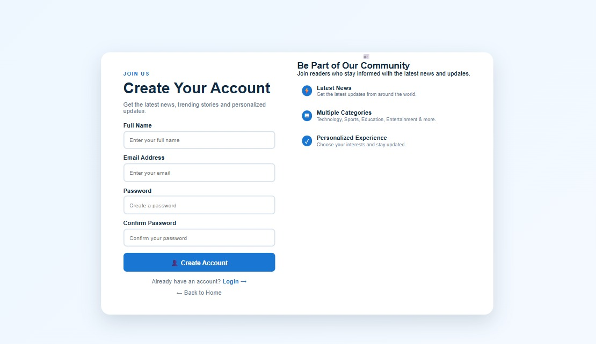
User Registration & Personalization
The account page is designed to convert a visitor into a registered reader
Registration Flow
Full name and email identify the reader.
Password and confirmation fields reduce entry errors.
A clear Create Account action keeps the conversion path simple.
Existing users can move directly to Login.
The page communicates benefits: latest news, multiple categories and personalized experience.
6

Slide 7
Conclusion & Future Scope
1
Current concept
A clean news-discovery interface with search, trending stories, latest news and categories.
2
User layer
Account creation creates the foundation for personalization and saved preferences.
3
Next step
Connect the interface to real news APIs/database sources and implement authentication.
4
Future features
Personalized feeds, bookmarks, notifications, admin moderation and analytics.
Thank You
7

